Slide 1
Design and Analysis of Algorithms CS345
Lecture 4
Multiplying two Polynomials
Data Structures :
The power of Binary Search Tree

Slide 2
Recap from Lecture 3

Slide 3









Divide and Conquer approach
$A\left(x\right)=a_{0}+a_{1}x+a_{2}x^{2}+a_{3}x^{3}+…+a_{n−2}x^{n−2}+a_{n−1}x^{n−1}$
= ? $+$ ?
Question:
If $A_{even}(x)$= $a_{0}+a_{2}x+ …+a_{n−2}x^{\frac{n}{2}−1}$
and $A_{odd}(x)$ = $a_{1}+a_{3}x+ …+a_{n−1}x^{\frac{n}{2}−1}$,
then what is the relation between $A$, $A_{even}$, and $A_{odd}$ ?
Answer: ?
➔Evaluating $A\left(x\right)$ on $S$ $≡$ ? + ? +
$$\left(a_{0}+a_{2}x^{2}+…+a_{n−2}x^{n−2}\right)$$
$x(a_{1}+a_{3}x^{2}+…+a_{n−1}x^{n−2}$)
$A_{even}$($x^{2}$)
?
$A_{odd}$($x^{2}$)
?
$A\left(x\right)=$ $A_{even}$($x^{2}$) + $x A_{odd}$($x^{2}$)
Evaluating $A_{even}\left(x\right)$ at $S^{2}$
Evaluating $A_{odd}\left(x\right)$ at $S^{2}$
O($n$) work

Slide 4






















Solving the sub-problem
points
for
evaluation
$A\left(x\right)=$ $A_{even}$($x^{2}$) + $x A_{odd}$($x^{2}$)
degree
$$A$$
$$<n$$
$$S$$
$$n$$
Question: Is it possible to select $S$ such that
…
$$A_{even}$$
$$A_{odd}$$
$$<n/2$$
$$S^{2}$$
$$n$$
$$<n/4$$
$$S^{4}$$
$$n$$
$$<1$$
$$S^{n}$$
$$n$$
$n$ polynomials, each to be evaluated at $n$ distinct numbers
$Θ\left(n^{2}\right)time$☹
This hurdle is pointing to a very important question whose answer will solve this problem …
Now recall the set $S$
you selected. What is the size of $S^{2}$, $S^{4}$, …, $S^{n}$ ?
$${|S}^{2}|=\frac{n}{2}$$
$${|S}^{4}|=\frac{n}{4}$$
$${|S}^{n}|=1$$

Slide 5











Complex roots of unity
$$R_{3}$$
What is $\left\{x^{2} \right|x∈R_{3}\}$ ?
$$R_{4}$$
What is $\left\{x^{2} \right|x∈R_{4}\}$ ?
$$ω_{4}^{1}$$
$$ω_{3}^{1}$$
$$ω_{3}^{3}$$
$$ω_{4}^{2}$$
$$ω_{4}^{4}$$
$$ω_{3}^{2}$$
$$ω_{4}^{3}$$
$$R_{3}$$
$$R_{2}$$

Slide 6
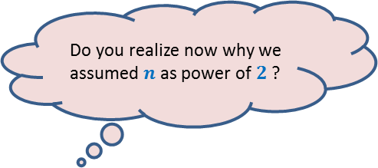




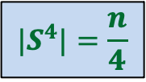
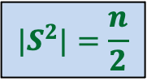
Complex roots of unity
Theorem:
If $n$ is odd $R_{n}^{2}=R_{n}$
If $n$ is even$R_{n}^{2}=$ $R_{\frac{n}{2}}$
Is it possible to select $S$ such that
…
?
$${|S}^{2}|=\frac{n}{2}$$
$${|S}^{4}|=\frac{n}{4}$$
$${|S}^{n}|=1$$
Yes! Choose
$$S=R_{n}$$
Do you realize now why we assumed $n$ as power of $2$ ?

Slide 7


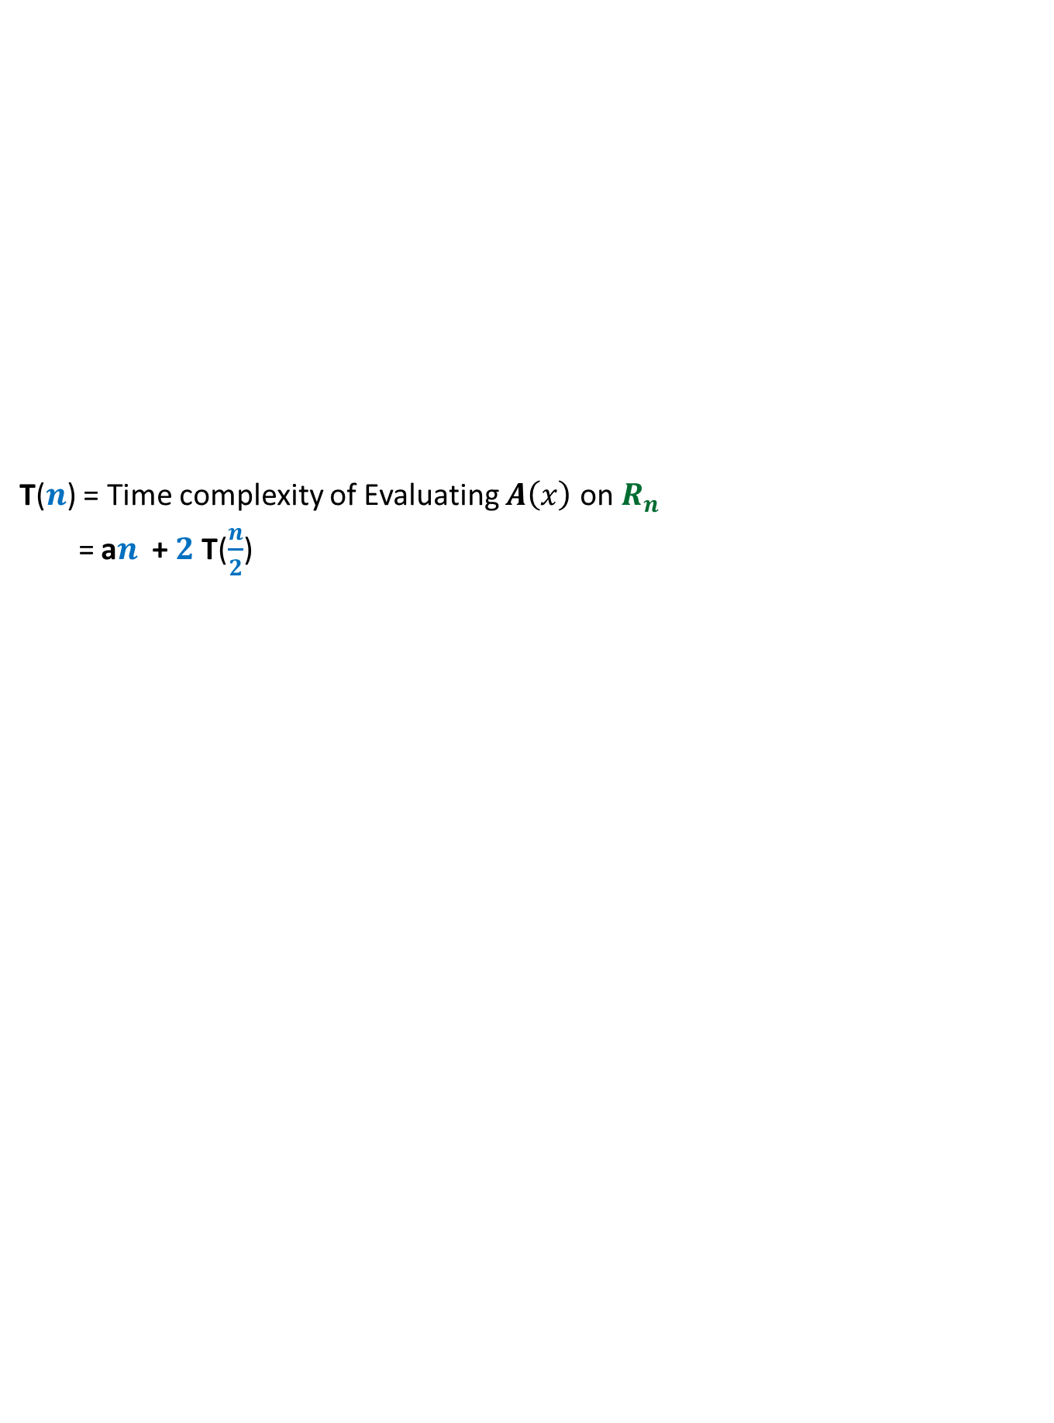


Solving the sub-problem
points
for
evaluation
$A\left(x\right)=$ $A_{even}$($x^{2}$) + $x A_{odd}$($x^{2}$)
degree
$$A$$
$$<n$$
$$R_{n}$$
T($n$) = Time complexity of Evaluating $A\left(x\right)$ on $R_{n}$
= a$n$ + $2$T($\frac{n}{2}$)
$$A_{even}$$
$$A_{odd}$$
$$<n/2$$
$$R_{\frac{n}{2}}$$
$$<n/4$$
$$R_{\frac{n}{4}}$$
$$<1$$
$$R_{1}$$

Slide 8
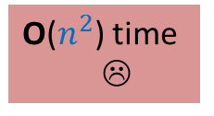

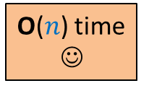
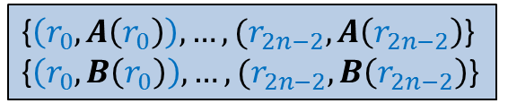


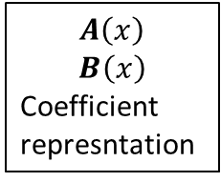

O($n^{2}$) time
☹
$$A\left(x\right)$$
$$B\left(x\right)$$
Coefficient
represntation
<$a_{0}, a_{1},a_{2},…,a_{n−1}$>
<$b_{0}, b_{1},b_{2},…,b_{n−1}$>
<$c_{0}, c_{1},c_{2},…,c_{2n−2}$>
O($n$ log $n$) time
Done
?
O($n$ log $n$) time
{$\left(r_{0}, A\left(r_{0}\right)\right),…,(r_{2n−2}, A\left(r_{2n−2}\right)$}
{$\left(r_{0}, B\left(r_{0}\right)\right),…,(r_{2n−2}, B\left(r_{2n−2}\right)$}
{$\left(r_{0}, C\left(r_{0}\right)\right),…,(r_{2n−2}, C\left(r_{2n−2}\right)$}
O($n$) time
☺

Slide 9



Sub-problem 2
Given a polynomial $C\left(x\right)$ of degree less than $n$in (point,value) representation,
Compute its coefficient representation.
Given $\left\{d_{0},d_{1},…,d_{n−1}\right\}$ where
$d_{j}=C\left(ω_{n}^{j}\right)$
How to infer $c_{i}$ ?
Homework: Establish a relation between $D\left(ω_{n}^{k}\right)$ and $c_{n−k}$ ?
Do this homework sincerely if you wish to internalize the entire solution of the problem …
$$C\left(x\right)=c_{0}+c_{1}x+c_{2}x^{2}+ …c_{n−1}x^{n−1}$$
What should be that polynomial.
…Think simple ☺
Hint: This problem can also be viewed as an instance of Sub-problem 1.
$$D\left(x\right)=d_{0}+d_{1}x+d_{2}x^{2}+ …d_{n−1}x^{n−1}$$

Slide 10
To test your coding skills
Homework:
The algorithm involves complex roots of unity. But these numbers are
imaginary (not supported in programming language☹.)
So how to write the code of the algorithm in C ?

Slide 11
Revisiting Binary Search Tree

Slide 12

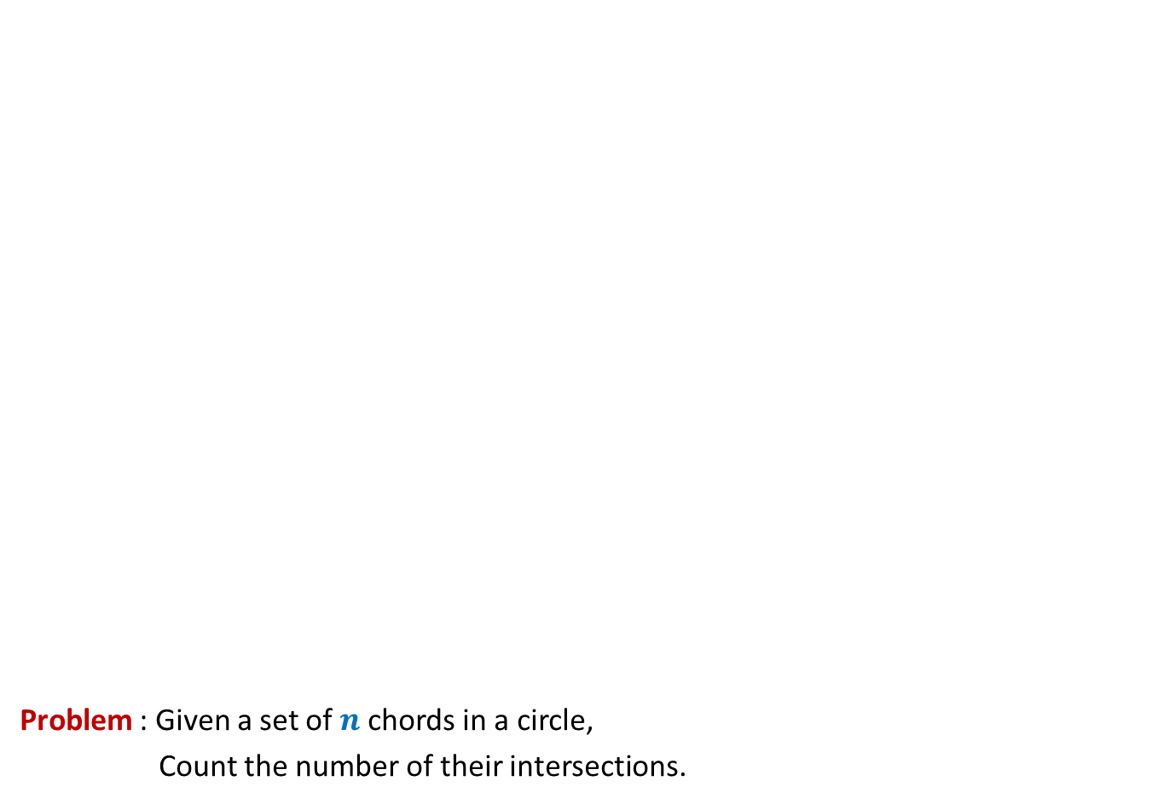
Problem : Given a set of $n$chords in a circle,
Count the number of their intersections.
O($n$ log $n$)

Slide 13
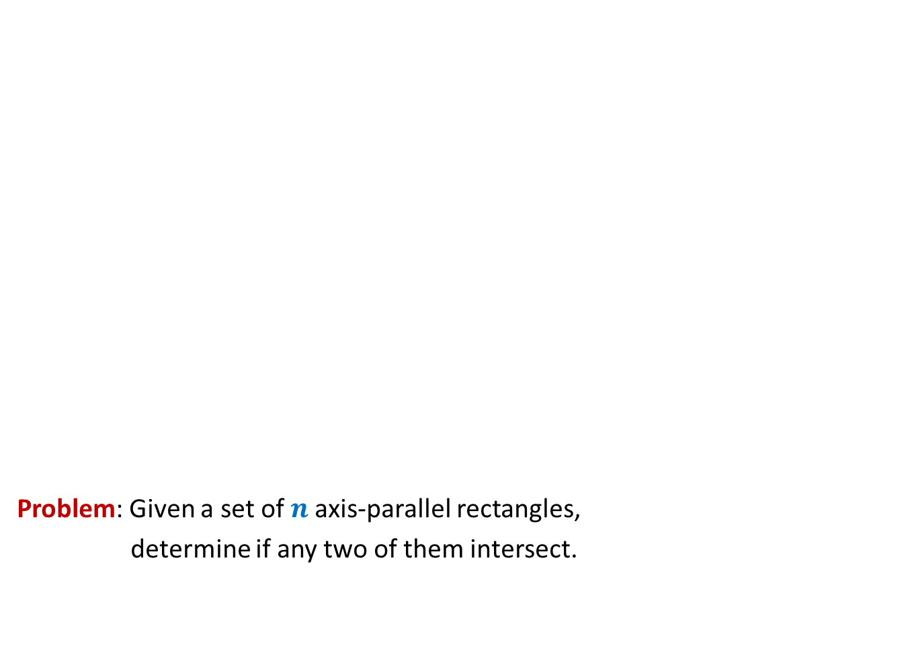
Surprising applications of data structures
Problem: Given a set of $n$axis-parallel rectangles,
determine if any two of them intersect.
O($n$ log $n$)

Slide 14
Red Black tree (Height Balanced BST)
Operations you already know
Search(T,x)
Insert(T,x)
Delete(T,x)
Min(T)
Max(T)
Predecessor(T,x)
Successor(T,x)
A NOTATION
T < T’ :
every element of T is smaller than every
element of T’.
8. SpecialUnion(T, T’):
Given T and T’ such that T < T’,
compute T*=TUT’.
NOTE: T and T’ don’t exist after the union.
9. Split(T, x):
Split T into T’ and T’’ such that T’ < x < T’’.
Every operation in O(log n) time.

Slide 15
Red-Black Tree
How well have you understood it ?

Slide 16
Insertion in a red-black tree
Can you handle color-imbalance
in general as well ?
T
46
Yes
28
67
5
35
49
83
2
25
31
41
54
44
Color imbalance

Slide 17
SpecialUnion(T,T’)
Remember:
every element of T is smaller than every element of T’

Slide 18
SpecialUnion(T,T’)

Slide 19
A trivial algorithm that does not work
Time complexity: O(log n)
Height balance lost
<
T
T’

Slide 20
Towards an O(log n) time for SpecialUnion(T,T’) …
Can we solve some simple cases easily ?
Simplifying the problem
Solving the simpler version efficiently
Extending the solution to generic version

Slide 21
Simplifying the problem
Simplified problem:
Given two trees T, T’ of same black height
and a key x, such that T<x<T’,
transform them into a tree T*=TU{x}UT’
x
<
<
T
T’

Slide 22
Solving the simplified problem
Simplified problem:
Given two trees T, T’ of same black height
and a key x, such that T<x<T’,
transform them into a tree T*=TU{x}UT’
x
O (1) time
<
<
T
T’

Slide 23
Extending the algorithm to the generic problem
T
T’

Slide 24
Extending the algorithm to the generic problem
x
<
<
T
T’

Slide 25
Extending the algorithm to the generic problem
x
T
T’

Slide 26
Extending the algorithm to the generic problem
x
T
T’

Slide 27
Extending the algorithm to the generic problem
v
x
T
T’’

Slide 28
Extending the algorithm to the generic problem
v
x
T
T’’

Slide 29

Extending the algorithm to the generic problem
Algorithm for SpecialUnion(T,T’):
Let x be the node storing smallest element of T’.
Delete the node x from T’.
Let black height of T ≤ black height of T’
Keep following left pointer of T’ until we reach a node v such that
left(v) is black
The subtree T” rooted at Left(v) has black height same as that of T
left(x)← T;
right(x) ← T”;
Color(x)← red;
left(v)← x;
parent(x)← v;
If color(v) is red, remove the color imbalance
(like in the usual procedure of insertion in a red-black tree)
Total time : O(log $n$)

Slide 30
Split(T,x)

Slide 31

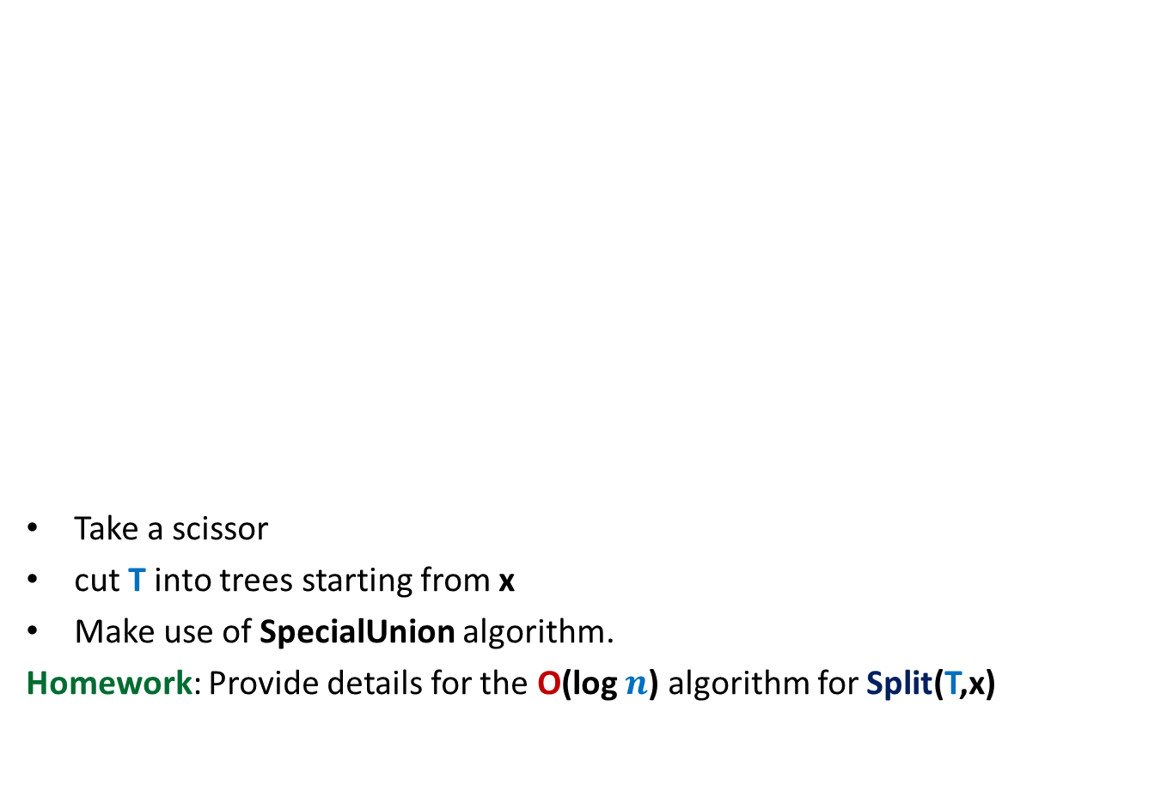

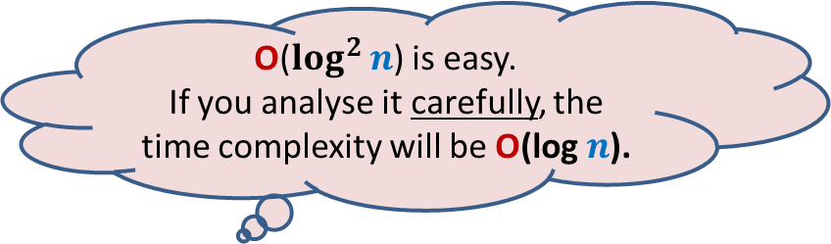
Achieving O(log $n$) time for Split(T,x)
O($\log^{2}{n}$) is easy.
If you analyse it carefully, the time complexity will be O(log $n$).
Take a scissor
cut T into trees starting from x
Make use of SpecialUnion algorithm.
Homework: Provide details for the O(log $n$) algorithm for Split(T,x)
x
T

Slide 32
Height Balanced BST (Red-black tree, AVL tree)
Operations you already know
New operation
Search(T,x)
Insert(T,x)
Delete(T,x)
Min(T)
Max(T)
Predecessor(T,x)
Successor(T,x)
SpecialMerge(T, T’)
Split(T,x)
10. FindRank(T, x):
return the no. of elements in T that are smaller
than x.
Every operation in O(log n) time.

Slide 33
Find-rank(T,x)

Slide 34

A trivial algorithm for Find-rank(T,x)
T
Repeatedly find predecessors of x and stop when you reach the min element.
Time complexity: O ($k$ log $n$) (where $k$ is rank of x in T)
Homework: Show that all predecessors can be computed in O($k$+ log $n$) time.
46
28
67
5
35
49
2
25
31
41
48
53

